Slide 1

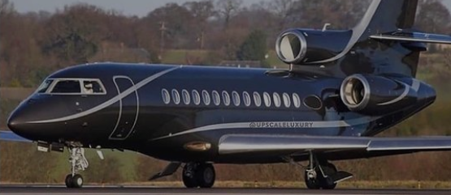
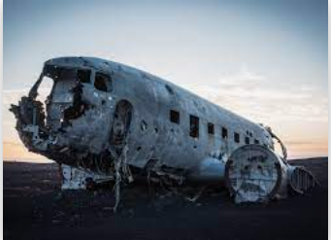

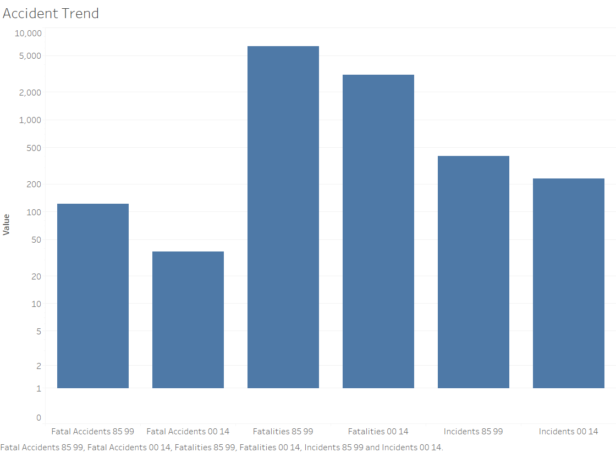

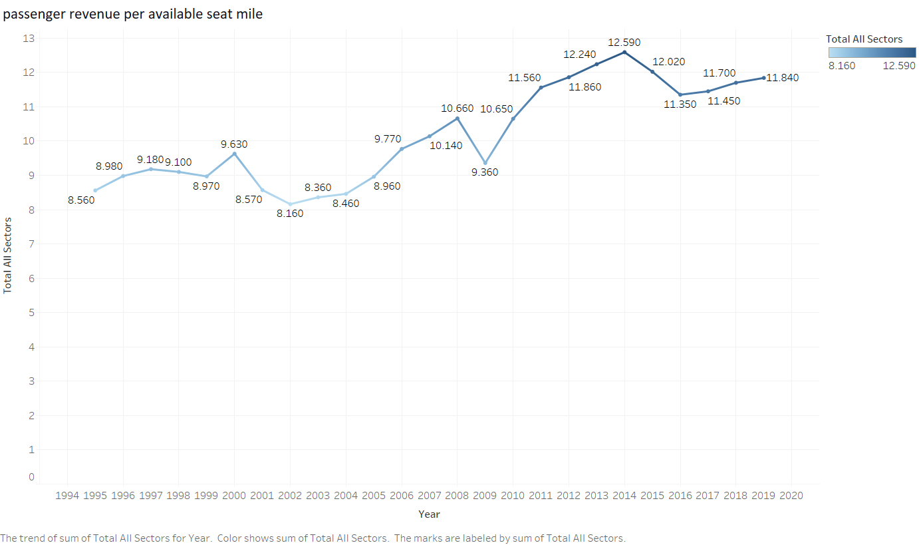

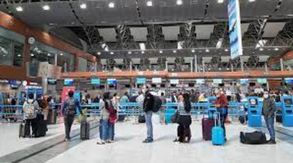

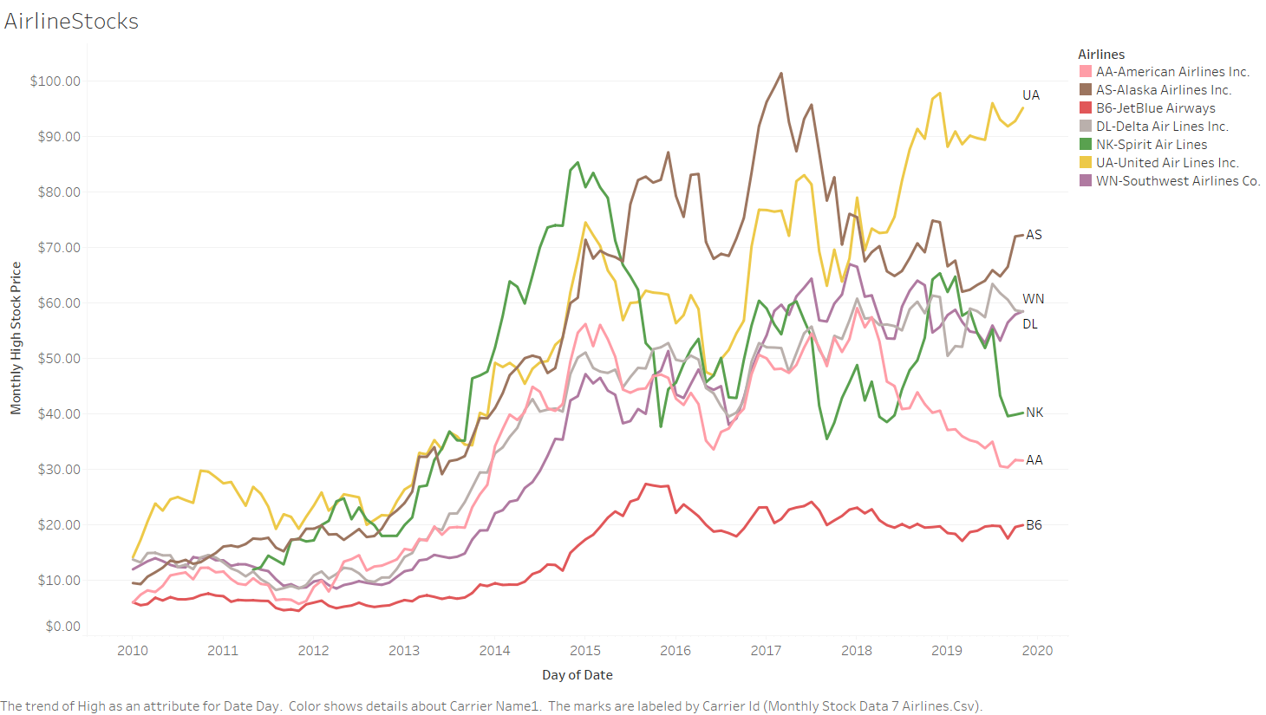

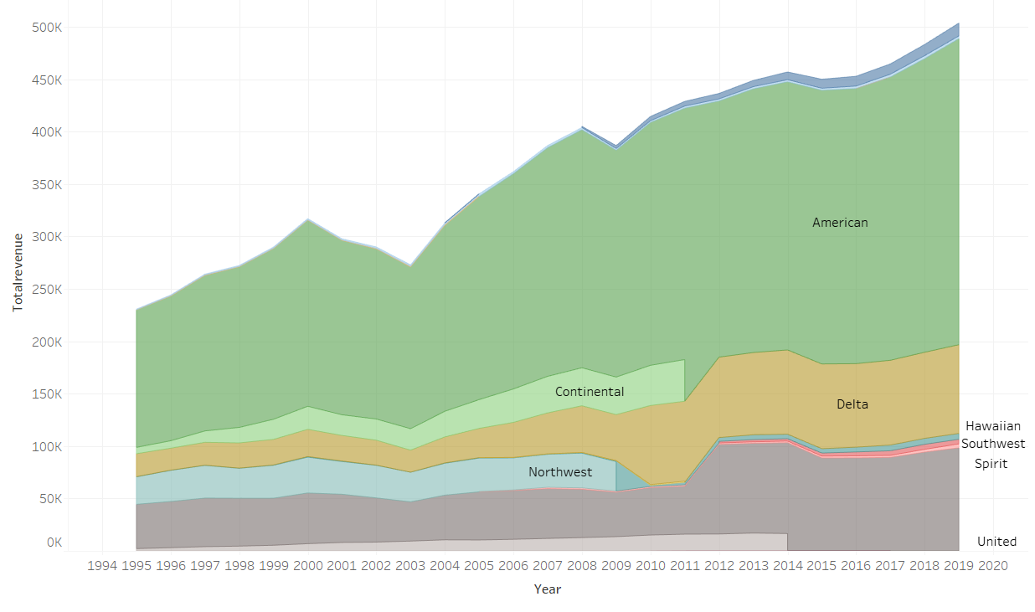
1985-1999
2000-2014
Does the Fatalities affected the U.S Airline revenue growth? Is it safe to travel?
Airline Accidents and Fatalities
51%
43%
Fatal accidents are reduced by 70%.
Significant reduction is identified in Fatalities and Incidents compared to past decade
70 %
Passenger Revenue Per Available Seat Mile
2014 was the highest with an increase of 47%
38% increase in passenger per revenue mile in 2019
Airline Stocks and Trends
In 2010 the Airline’s least stock was $6 and currently it is trending at $95.
1483% increase in airline stocks
Airline’s Market leader
American Airlines is leading the market share followed by Delta and United
Sources:
data.world, . (2019). BTS Airline Fuel Data by Carrier 2010-2019. https://data.world/utmlfall2019/bts-airline-fuel-data-by-carrier-2010-2019.
United States Department of Transportation. (2019). U.S. Air Carrier Safety Data. U.S. Air Carrier Safety Data | Bureau of Transportation Statistics. https://www.bts.gov/content/us-air-carrier-safety-data.
MIT. Global Airline Industry Program. (2006). Airline Data Project. http://web.mit.edu/airlinedata/www/Traffic&Capacity.html.
Airline safety: https://github.com/fivethirtyeight/data/tree/master/airline-safety
Blog link:
https://asumbaraju-airlineperformance.blogspot.com/2021/07/does-negative-media-buzz-affect.html

